Slide 1
Ocean Current Velocity and its relationship with Coral Bleaching
Group: Reef P2
Kitty, Harry, Ollie, Bryan
Notes:
Interdisciplinary subject: we were exploring whether there is any correlation between ocean current velocity and coral bleaching.

Slide 2
MOtivation and context
Motivation:
The relationship between Ocean Currents and Thermal Stress
Context:
Conflicting literature exists on how ocean currents affect coral bleaching
Notes:
Kitty
Explain what is ocean current velocity:
We decided on this based on the fact that thermal activity and ocean currents are closely related (for example, stronger ocean currents carry cooler water to the surface and this can impact the change in temperature which makes corals more susceptible to bleaching). Hence, our hypothesis claims that there is a relationship between ocean current velocity and coral bleaching.
Explain the conflicting literature, that supports both views.
MARS Research reveals there is conflicting literature with some sources stating that stronger ocean currents enhance mass bleaching, others say that currents are also capable of aiding in coral recovery.

Slide 3
Data collection & preprocessing
ReefCheck data + AIMS (Australian Institute of Marine Science) ocean current data
Merge data based on coordinates
Narrow data by coordinates to the Great Barrier Reef
Average data over each month of each year
Notes:
Bryan
In addition to the reefcheck data that we are all aware of, we have also included ocean current data from AIMS, which is the Australian Institute of Marine Science. After merging the data sets based on geographical coordinates, we narrowed down the reef points to those located in the Great Barrier Reef. The data is then further grouped over year and month and averaged over columns. Kitty will introduce our model evaluation process.

Slide 4
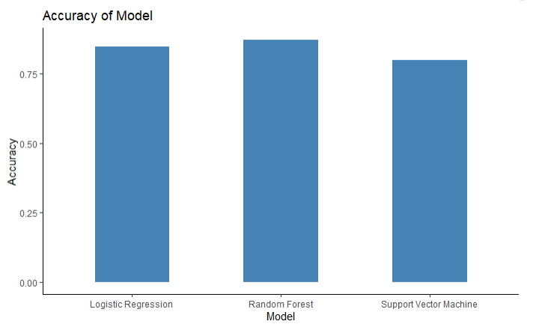
Models: Evaluation
ACCURACy
Notes:
Accuracy was extracted from 5-fold cross validation on the logistic model which gave an accuracy of 0.84, Random forest had 0.87 and Support vector machine was 0.83
Here we see that the accuracy for random forest is the highest and the most accurate classification model.

Slide 5
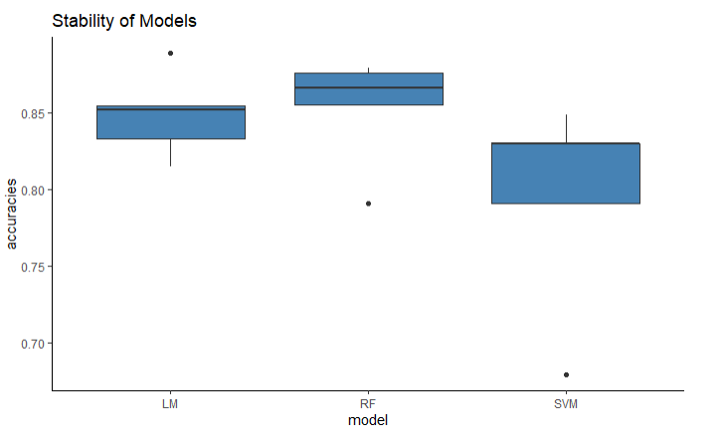
Models: Evaluation
stability
Notes:
Stability of the models were taken from the accuracy of each of 5 folds used in cross validation, with only 1 repeat. This reflects the accuracy of Random Forest being the highest.

Slide 6
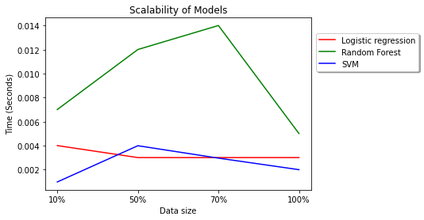
Models: Evaluation
scalability
Notes:
For scalability, we measured the time for the model to run samples of 10%, 50%, 70% and 100% of its data. All models run in under a second considering the small data size.

Slide 7
Model interpretation
No significance in p-values between coral bleaching and mean currents
Contradicts hypothesis that ocean currents affect coral bleaching
Notes:
All our models show no significance in p-values between coral bleaching and mean ocean current velocity. This contradicts our hypothesis that ocean currents affect coral bleaching.

Slide 8
The product
Python Dash
Run R code in Python using rpy2
Interactive maps
Allow marine scientists to make predictions of coral bleaching
Visualizes all predictions made
Notes:
Bryan
For the end product, we have opted to build our app using Python Dash, for its ease of use and our group’s relative confidence in Python compared to R. To integrate R code into python we have used the rpy2 package, making it possible for the dash to run R commands.
The app has interactive maps and allow users to make predictions of coral bleaching. All predictions that a user has made is visualized on the interactive maps.

Slide 9
Demonstration of Dash
Notes:
Bryan

Slide 10
Conclusion
Ocean current velocity and coral bleaching have no relationship
Contradicting our hypothesis, but supported by previous research
The Dash is great for visualizing and presenting results
Future research: larger data sets on larger areas, more complex models, current direction’s influence
Notes:
As explained, ocean current velocity and coral bleaching have no relationship, that is current is not a good indicator of coral bleaching. This finding contradicts our hypothesis but it doesn’t come as a surprise, as there had been conclusions drawn either way in previous research. What we can confirm is that the Python Dash is great for visualizing and presenting results. Future directions of research may include: finding larger data sets in combination with more complex and sophisticated models. There is also literature suggesting ocean current’s direction may have an impact on coral bleaching, which was not in the scope of this project.

Slide 11
Reference
Introduction of context:
https://www.whoi.edu/oceanus/feature/coral-current-connections/
https://news.stanford.edu/2016/09/16/wave-dynamics-water-flows-affect-coral-reefs/
https://journals.plos.org/plosone/article?id=10.1371%2Fjournal.pone.0080536
Notes:
Kitty

Slide 12
Contribution
Kitty: Creating slides (1-4, 7-11), writing script, speaking
Bryan: Creating slides (1-3, 8-10), writing script, speaking, app demonstration
Ollie: Creating slides 6, writing script
Harry: Creating slides 14, writing script, speaking
Notes:
Fill in what you’ve done for the presentation

